Slide 1

A look into nationwide mortality rates and the possible effect on healthcare costs

Slide 2

AGENDA
Aim of the Project
Foundational Questions
Chronic Disease Mortality Rates Across the United States
Mortality Rates Across the United States
Healthcare Costs by Region
Findings
Ethical Considerations

Slide 3

The aim of our project is to identify trends in healthcare outcomes. This project will look at the relationship between healthcare costs and death rates across the United States to find any correlation apparent that could show the following:

Slide 4

- Do higher mortality rates due to higher chronic illness lead to an increase in healthcare costs by region? - Do higher healthcare costs create a higher mortality rate due to inability to obtain proper healthcare? - What are the most cost friendly states to live in when it comes to healthcare?

Slide 5
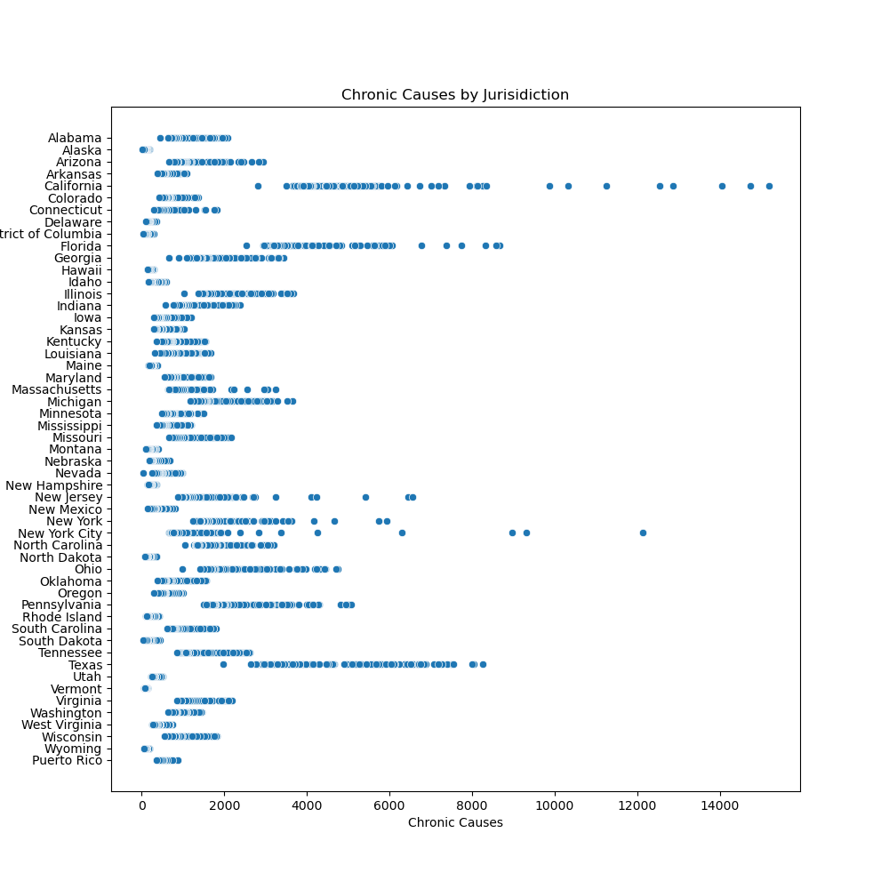
Chronic Disease Mortality Rates Across the United States

Slide 6
SELECTING VISUAL AIDS
ENHANCING YOUR PRESENTATION

Slide 7
EFFECTIVE DELIVERY TECHNIQUES
Effective body language enhances your message, making it more impactful and memorable.
Meaningful eye contact
Purposeful gestures
Maintain good posture
Control your expressions
This is a powerful tool in public speaking. It involves varying pitch, tone, and volume to convey emotion, emphasize points, and maintain interest.
Pitch variation
Tone inflection
Volume control

Slide 8
NAVIGATING Q&A SESSIONS
Know your material in advance
Anticipate common questions
Rehearse your responses
Maintaining composure during the Q&A session is essential for projecting confidence and authority. Consider the following tips for staying composed:
Stay calm
Actively listen
Pause and reflect
Maintain eye contact

Slide 9

SPEAKING IMPACT
Your ability to communicate effectively will leave a lasting impact on your audience
Effectively communicating involves not only delivering a message but also resonating with the experiences, values, and emotions of those listening

Slide 10
DYNAMIC DELIVERY
Learn to infuse energy into your delivery to leave a lasting impression
One of the goals of effective communication is to motivate your audience
Metric | Measurement | Target | Actual
Audience attendance | # of attendees | 150 | 120
Engagement duration | Minutes | 60 | 75
Q&A interaction | # of questions | 10 | 15
Positive feedback | Percentage (%) | 90 | 95
Rate of information retention | Percentage (%) | 80 | 85

Slide 11
FINAL TIPS & TAKEAWAYS
Consistent rehearsal
Strengthen your familiarity
Refine delivery style
Pacing, tone, and emphasis
Timing and transitions
Aim for seamless, professional delivery
Practice audience
Enlist colleagues to listen & provide feedback
Seek feedback
Reflect on performance
Explore new techniques
Set personal goals
Iterate and adapt

Slide 12
SPEAKING ENGAGEMENT METRICS
Impact factor | Measurement | Target | Achieved
Audience interaction | Percentage (%) | 85 | 88
Knowledge retention | Percentage (%) | 75 | 80
Post-presentation surveys | Average rating | 4.2 | 4.5
Referral rate | Percentage (%) | 10 | 12
Collaboration opportunities | # of opportunities | 8 | 10

Slide 13

THANK YOU
Brita Tamm
502-555-0152
brita@firstupconsultants.com
www.firstupconsultants.com

